Slide 1


Workers’ Rights
Stand up for what matters

Slide 2


Message from Scott Travers, Society President

Slide 3
What is “Right-to-Work” Legislation?
So called “Right-to Work” legislation generally seeks to do at least two things:
    Impair the representational and political capacity of unions by starving them of financial resources (i.e. dues revenues)
    Shift the resources and attention of unions from workplace and political advocacy on behalf of their members to collection of dues from their members

Slide 4
NO Free Ride!
Please see: http://www.youtube.com/watch?v=qCqRkn1IRnM

Slide 5
What’s It Like To Work Under Right to Work Legislation?
Please see: http://www.youtube.com/watch?v=7k4q2OPIpmM

Slide 6



What Is The Labour Movement Doing?
Sustained and concerted educational and mobilization efforts to expose the truths around Right To Work (RTW).
These efforts are focused internally at our own members and externally at the voting public.

Slide 7





What Is The Labour Movement Doing?
Individual unions, informal coalitions and central labour bodies at various levels are all working on developing responses to this threat.
  Polling and focus groups
  Messaging and educational material development
  Media outreach
  Public relations campaigns
  Political action/electoral involvement

Slide 8


What Is The Labour Movement Doing?
Further information
      http://ofl.ca/index.php/campaigns/workersrights/
      http://www.labourcouncil.ca/workersrights.html
      http://www.canadianlabour.ca/action-center/together-fairness-works

Slide 9
What Is The Society Doing?
  The Society Is Mobilizing Members
  Attended Toronto York Region Labour Council (TYRLC) campaign kick-off
  In house pilot training session for elected representatives to help fine-tune the campaign.
  Passed a motion at the 2013 Society Council to develop and roll-out a campaign strategy and built the capacity of elected representatives to help them lead this campaign.
  Set firm timelines to rollout this campaign to the membership

Slide 10
Society Council 2013
Motion
Whereas the delegates to Society Council 2013 recognize the threat to our members and all workers posed by the unprecedented attack on workers’ rights;
THEREFORE be it resolved that Society Central shall develop a plan to ensure that each Society member is engaged and educated about the on-going threat to their collective bargaining rights, pension and benefits,
THEREFORE be it resolved that within 1 month Society Central bring representation from each Local to customize the membership engagement plan that meets the needs of their members;
THEREFORE be it further resolved that Society Central shall provide each Local with assistance as necessary to ensure that each member receives personal contact to educate them about the threat to their rights by March 31, 2014.
Notes:
This motion was passed at Society Council 2013
Mover: Leonard Day (Hydro One Local)
Seconder: Alex Saba (OPG Local)

Slide 11
What Has Transpired Since This Motion Was Passed?
Scott Travers appointed 2 elected representatives to lead the Workers’ Rights campaign – Michelle Johnston, EVP-Policy & Keith Rattai-LVP, Hydro One
Initial meeting with the LVP’s took place on November 14, 2013 and a Workers’ Rights Committee was struck
Subsequent meetings ensued and significant work has been done to ensure the Workers’ Rights campaign reaches all members

Slide 12

What Has Transpired Since This Motion Was Passed?
Workers’ Rights Committee members:
  Michelle Johnston – Chair
  Keith Rattai – Chair
  Jim Botari – Hydro One Local
  Dave Brown – IESO Local
  David Brown-OEB Local
  Jose Freire-Canosa-NWMO Local
  Renee Frost/Dianne Mowat-Inergi Local
  Mike Gade-Bruce Power Local
  Camber Muir/Sophia Fung-AMEC NSS Local
  Alex Saba-OPG Local
  Andrea Zamecnik-New Horizon Local

Slide 13


What Has Transpired Since This Motion Was Passed?
Now we need YOU
  to become informed,
  to talk to friends and family and
  to vote in the next Provincial election

Slide 14
What Is The Society Doing?
  The Society Is Mobilizing Members
  Each Local has developed its own Local Engagement Plan with the goal of speaking face-to-face with every single member of their Local about this campaign by March 31, 2014.
  Get educated and get involved. You can’t afford not to. For more information, contact your Local Vice President.
  https://www.thesociety.ca/workersrights/

Slide 15

The Attack on Workers’ and Union Rights is Not New
Since 1980, 196 of 212 labour laws passed have eroded
workers’ rights.
Most recently from a Federal level:
Bill C-377 (Federal) – Financial reporting
Back-to-work legislation used 5 times in 2 years (Federal)
Bill C-525 [Federal] – Obtaining more than 50% of entire bargaining unit to become certified

Slide 16
The Attack on Workers’ and Union Rights is Not New
Most recently from a Provincial level:
Bill 62 [Ontario] – Removal of card certification
Bill 63 [Ontario] - Removal of OLRB’s power to make procedural rules
Bill 64 [Ontario] – Union dues

Slide 17

It Doesn’t Stop There….
Tim Hudak has taken the attack on workers and their unions to a new level with his white paper entitled “Paths to Prosperity” – Flexible Labour Markets.
This is unprecedented in Canadian history. It is a page that is taken from the right-wing "Tea Party" in U.S. politics

Slide 18
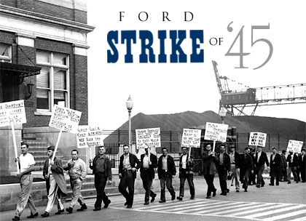
What is the Rand Formula?
Created by a decision of Supreme Court justice Ivan Rand, 1946
Designed to ensure that no employee can opt out of the union to avoid dues yet reap the benefits of the union's accomplishments
Created stable labour relations climate

Slide 19
What is the Rand Formula?
Rand Formula since 1946
Hudak’s Proposal
Everyone who is part of a union will pay union dues and reap the benefits related to collective bargaining.
Let union members choose whether or not to pay union dues however they would still reap the benefits related to collective bargaining.
Should people then have a choice NOT to pay taxes and still benefit from the services funded by taxes?

Slide 20
What’s at Risk For You?
They want to attack our Pensions
They want to establish a race to the bottom regarding our wages and salaries.
They want to undermine and minimize the Health and Safety protections that we have fought for over decades of struggle.
They want to weaken and distract our Unions

Slide 21
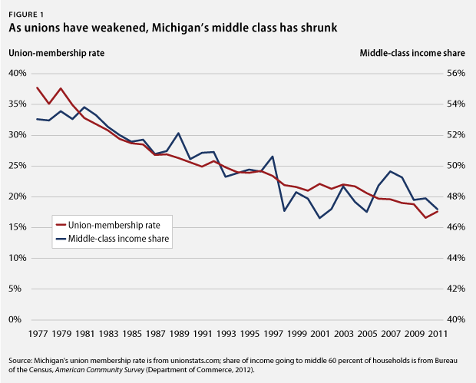
Impact of Right-to-Work
Union density in Canada 31.0%
Union density in U.S. 11.8%
Union density in RTW states 5.7%
In some RTW states, only ¼ to ½ of that 5.7% actually pays dues

Slide 22
Impact of Right-to-Work
RTW in the US = Lower Wages and Incomes
  The average worker in states with "right to work" laws makes $1,540 a year less when all other factors are removed than workers in other states.
  Median household income in states with these laws is $6,437 less than in other states ($46,402 vs. $52,839).
  In states with "right to work" laws, 26.7 percent of jobs are in low-wage occupations, compared with 19.5 percent of jobs in other states.

Slide 23
It’s About More Than Paycheques
Poverty and Infant Mortality
Right to Work States
Non Right to Work States
Poverty:
15.3 % overall and 21.5 % for children
Infant Mortality
15 % higher in states with these laws.
Poverty:
13.1 % overall and 18.1 % for children

Slide 24
It’s About More Than Paycheques
EDUCATION
Right to Work States
Non Right to Work States
vs.
RTW states spend $3,392 less per pupil on elementary and secondary education
  In RTW states students are less likely to be performing at their appropriate grade level in math and reading.

Slide 25
It’s About More Than Paycheques
RATES OF DEATH ON THE JOB
Right to Work States
Non Right to Work States
vs.
Rate of workplace deaths is 36 % higher in states with RTW laws

Slide 26

Fight Back For What Matters
Unions are OUR only chance
Unions are ALL of “US” not “them”
Include ALL workers, not just union members

Slide 27



Losing’s Not An Option
There’s too much on the line:
  OUR Families
  OUR Communities
  OUR Economy

Slide 28

EDUCATE YOURSELF
EDUCATE OTHERS
VOTE FOR WHO WILL BEST REPRESENT YOUR INTERESTS AS A WORKER

